Slide 1
UNIT 3
Perspective of Parallel Algorithms

Slide 2
Chapter Overview
Parallel Algorithm Design Models
  Data-Parallel, Work-Pool, Task Graph, Master-Slave, Pipeline, and Hybrid Models
Non–numerical algorithms
  sorting
  graph algorithms
  search algorithms for discrete optimization problems
  dynamic programming
Numerical algorithms
  dense matrix algorithms
  fast fourier transforms

Slide 3
Parallel Algorithm Models
Parallel algorithms are designed to solve computational problems faster by dividing the work among multiple processors. Instead of executing tasks sequentially, multiple operations run simultaneously, improving performance and scalability.
Parallel algorithms are broadly designed using parallel design principles and applied to non-numerical and numerical problems.
An algorithm model is a way of structuring a parallel algorithm by selecting a decomposition and mapping technique and applying the appropriate strategy to minimize interactions.

Slide 4
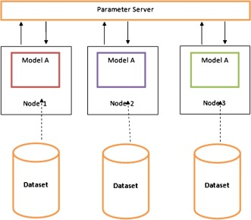
Parallel Algorithm Models (cont..)
Data Parallel Model: Tasks are statically (or semi-statically) mapped to processes and each task performs similar operations on different data.
Working
Input data is divided into smaller chunks.
Each processor receives one portion of the data.
All processors execute the same algorithm simultaneously.
Results are combined to produce the final output.
Example
Matrix operations
Image processing
Vector addition
Advantages
Simple to implement
Highly scalable
Efficient for large datasets

Slide 5
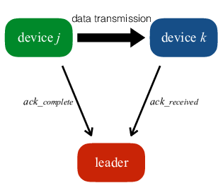
Parallel Algorithm Models (cont..)
2. Task Graph Model: Starting from a task dependency graph, the interrelationships among the tasks are utilized to promote locality or to reduce interaction costs.
In the task graph model, a computation is represented as a directed graph.
Nodes represent tasks
Edges represent dependencies between tasks
Working
  Dependencies determine execution order.
  Independent tasks run in parallel.
  Dependent tasks wait until required inputs are available.
Example
  Compiler design
  Scientific workflows
  Simulation systems
Advantage
  Efficiently manages task dependencies.

Slide 6
Parallel Algorithm Models (cont..)
3. Work Pool Model: In this model, a central pool of tasks is maintained. Processors repeatedly take tasks from the pool, execute them, and request new tasks.
Working
  Tasks are stored in a shared queue.
  Processors take available tasks dynamically.
  Completed tasks are removed from the pool.
  Load is balanced automatically.
Example
  Web servers
  Parallel search algorithms
Advantage
  Provides dynamic load balancing.

Slide 7
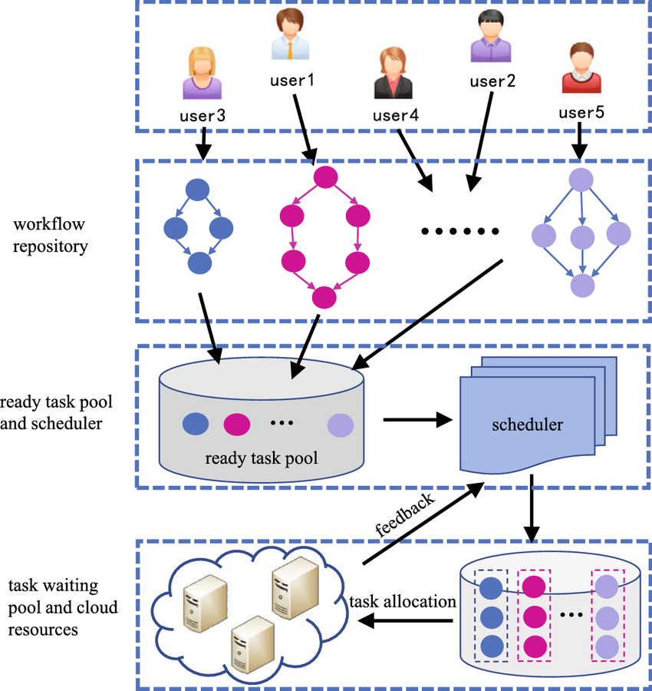
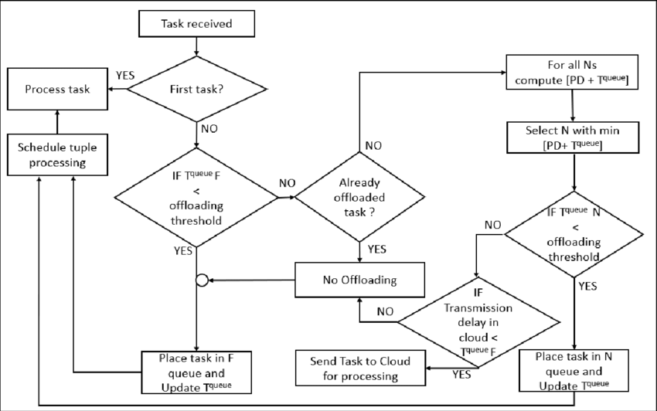
Parallel Algorithm Models (cont..)

Slide 8
Parallel Algorithm Models (cont..)
4. Master-Slave Model: One or more processes generate work and allocate it to worker processes. This allocation may be static or dynamic. One processor acts as the Master, while others act as Slave (Worker) processors.
Working
  Master divides the problem into tasks.
  Tasks are assigned to worker processors.
  Workers execute tasks and return results.
  Master combines results to produce the final output.
Example
  Distributed computing systems
  MapReduce-like frameworks
Advantage
  Easy control and coordination.

Slide 9
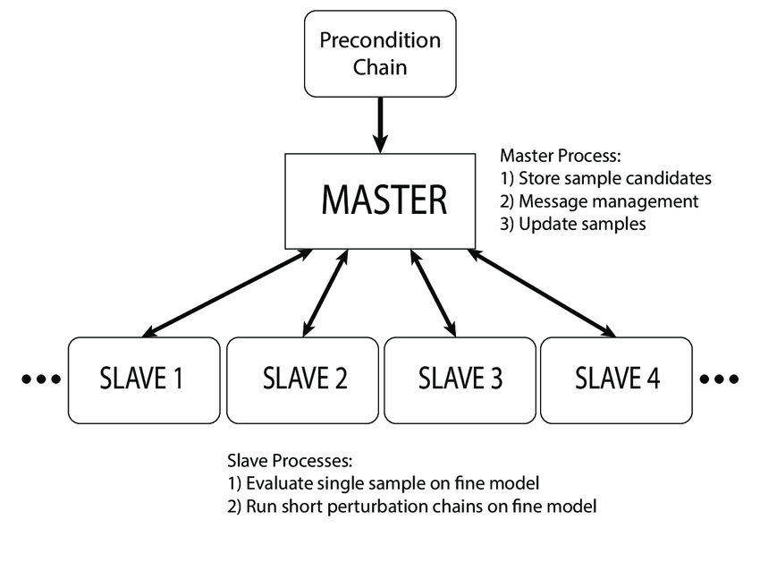
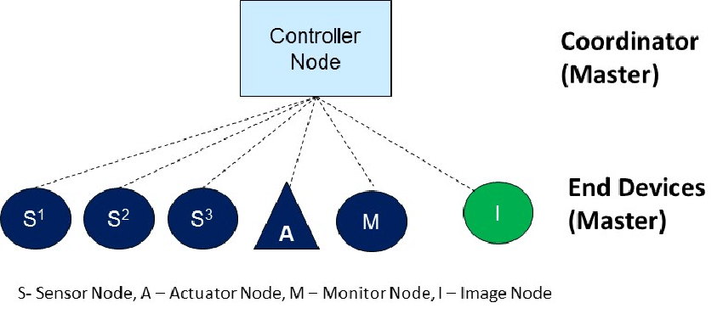
Parallel Algorithm Models (cont..)

Slide 10
Parallel Algorithm Models (cont..)
5. Pipeline / Producer-Consumer Model: A stream of data is passed through a succession of processes, each of which perform some task on it. The pipeline model divides computation into stages, where each processor performs one stage.
Working
  Data enters the first stage.
  Each stage processes the data.
  Output from one stage becomes input to the next stage.
Example
  Instruction execution in CPUs
  Multimedia streaming
  Data processing systems
Advantage
  Improves throughput by overlapping tasks.

Slide 11
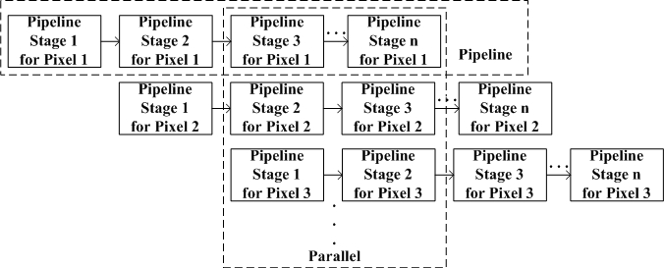
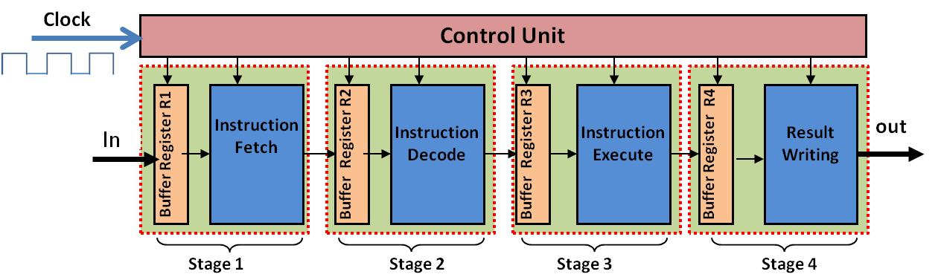
Parallel Algorithm Models (cont..)

Slide 12
Parallel Algorithm Models (cont..)
6. Hybrid Models: A hybrid model may be composed either of multiple models applied hierarchically or multiple models applied sequentially to different phases of a parallel algorithm.
Hybrid models combine two or more parallel design models to improve efficiency.
Example
  A system may combine:
    Data parallelism + pipeline
    Master–slave + work pool
Advantage
  Provides flexibility for solving complex problems.

Slide 13
Non-numerical Algorithms
Sorting
Graph algorithms
Search algorithms for discrete optimization problems
Dynamic programming

Slide 14
Sorting: Overview
One of the most commonly used and well-studied kernels.
The fundamental operation of comparison-based sorting is compare-exchange.
The lower bound on any comparison-based sort of n numbers is Θ(nlog n).

Slide 15
Sorting: Basics
What is a parallel sorted sequence? Where are the input and output lists stored?
We assume that the input and output lists are distributed.
The sorted list is partitioned with the property that each partitioned list is sorted and each element in processor P_{i}'s list is less than that in P_{j}'s list if i < j.

Slide 16
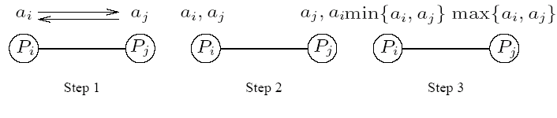
Sorting: Parallel Compare Exchange Operation
A parallel compare-exchange operation. Processes P_{i} and P_{j} send their elements to each other. Process P_{i} keeps min{a_{i},a_{j}}, and P_{j} keeps max{a_{i}, a_{j}}.

Slide 17
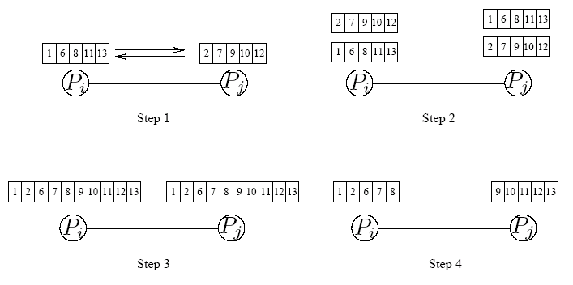
Sorting: Parallel Compare Split Operation
A compare-split operation. Each process sends its block of size n/p to the other process. Each process merges the received block with its own block and retains only the appropriate half of the merged block. In this example, process P_{i} retains the smaller elements and process P_{i} retains the larger elements.

Slide 18
Sorting Networks
Networks of comparators designed specifically for sorting.
A comparator is a device with two inputs x and y and two outputs x' and y'. For an increasing comparator, x' = min{x,y} and y' = min{x,y}; and vice-versa.
We denote an increasing comparator by ⊕ and a decreasing comparator by Ө.
The speed of the network is proportional to its depth.

Slide 19
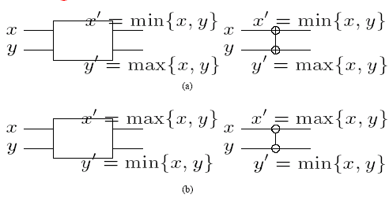
Sorting Networks: Comparators
A schematic representation of comparators: (a) an increasing comparator, and (b) a decreasing comparator.

Slide 20
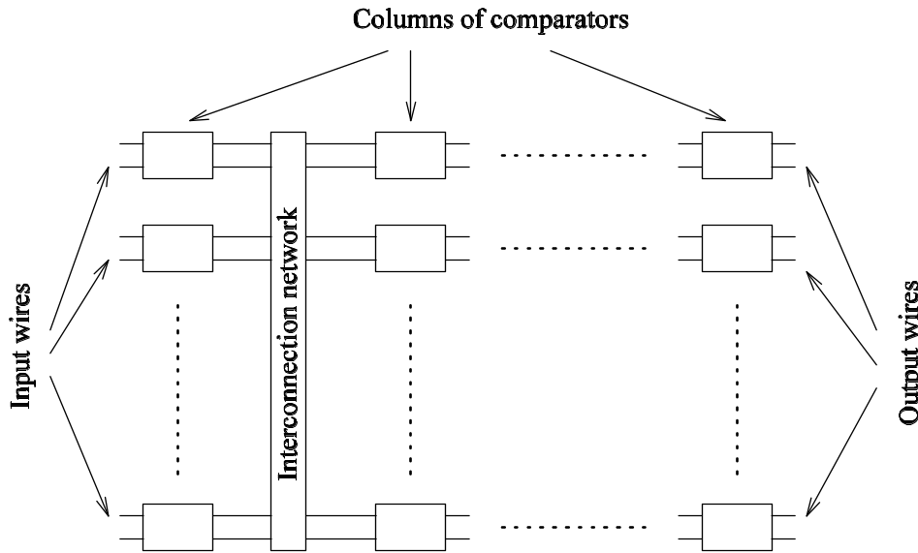
Sorting Networks
A typical sorting network. Every sorting network is made up of a series of columns, and each column contains a number of comparators connected in parallel.

Slide 21
Sorting Networks: Bitonic Sort
A bitonic sorting network sorts n elements in Θ(log₂n) time.
A bitonic sequence has two tones - increasing and decreasing, or vice versa. Any cyclic rotation of such networks is also considered bitonic.
⟨1,2,4,7,6,0⟩ is a bitonic sequence, because it first increases and then decreases. ⟨8,9,2,1,0,4⟩ is another bitonic sequence, because it is a cyclic shift of ⟨0,4,8,9,2,1⟩.
The kernel of the network is the rearrangement of a bitonic sequence into a sorted sequence.

Slide 22
Sorting Networks: Bitonic Sort
Let s = ⟨a₀,a₁,…,a_{n-1}⟩ be a bitonic sequence such that a₀ ≤ a₁ ≤ ··· ≤ a_{n/2-1} and a_{n/2} ≥ a_{n/2+1} ≥ ··· ≥ a_{n-1}.
Consider the following subsequences of s:
s₁ = ⟨min{a₀,a_{n/2}},min{a₁,a_{n/2+1}},…,min{a_{n/2-1},a_{n-1}}⟩
s₂ = ⟨max{a₀,a_{n/2}},max{a₁,a_{n/2+1}},…,max{a_{n/2-1},a_{n-1}}⟩
Note that s₁ and s₂ are both bitonic and each element of s₁ is less than every element in s₂.
We can apply the procedure recursively on s₁ and s₂ to get the sorted sequence.

Slide 23
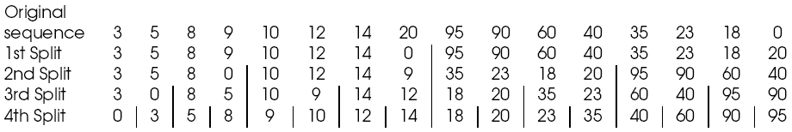
Sorting Networks: Bitonic Sort
Merging a 16-element bitonic sequence through a series of log 16 bitonic splits.

Slide 24
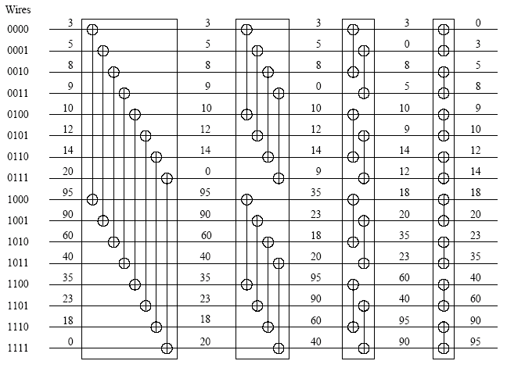
Sorting Networks: Bitonic Sort
A bitonic merging network for n = 16. The input wires are numbered 0,1,…, n - 1, and the binary representation of these numbers is shown. Each column of comparators is drawn separately; the entire figure represents a ⊕BM[16] bitonic merging network. The network takes a bitonic sequence and outputs it in sorted order.

Slide 25
Sorting Networks: Bitonic Sort
The depth of the network is Θ(log² n).
Each stage of the network contains n/2 comparators. A serial implementation of the network would have complexity Θ(nlog² n).

Slide 26
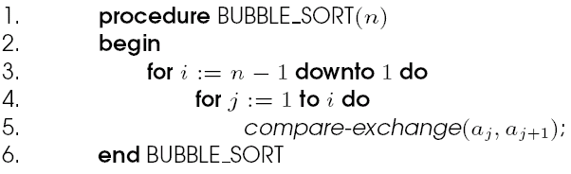
Bubble Sort and its Variants
The sequential bubble sort algorithm compares and exchanges adjacent elements in the sequence to be sorted:
Sequential bubble sort algorithm.

Slide 27
Bubble Sort and its Variants
The complexity of bubble sort is Θ(n²).
Bubble sort is difficult to parallelize since the algorithm has no concurrency.
A simple variant, though, uncovers the concurrency.

Slide 28
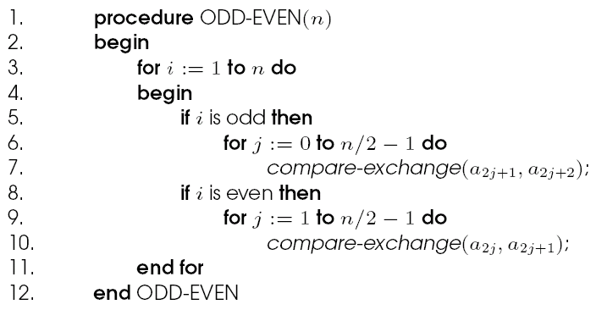
Odd-Even Transposition
Sequential odd-even transposition sort algorithm.

Slide 29
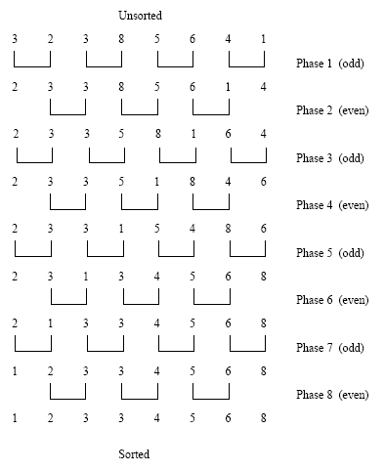
Odd-Even Transposition
Sorting n = 8 elements, using the odd-even transposition sort algorithm. During each phase, n = 8 elements are compared.

Slide 30
Odd-Even Transposition
After n phases of odd-even exchanges, the sequence is sorted.
Each phase of the algorithm (either odd or even) requires Θ(n) comparisons.
Serial complexity is Θ(n²).

Slide 31
Parallel Odd-Even Transposition
Consider the one item per processor case.
There are n iterations, in each iteration, each processor does one compare-exchange.
The parallel run time of this formulation is Θ(n).
This is cost optimal with respect to the base serial algorithm but not the optimal one.

Slide 32
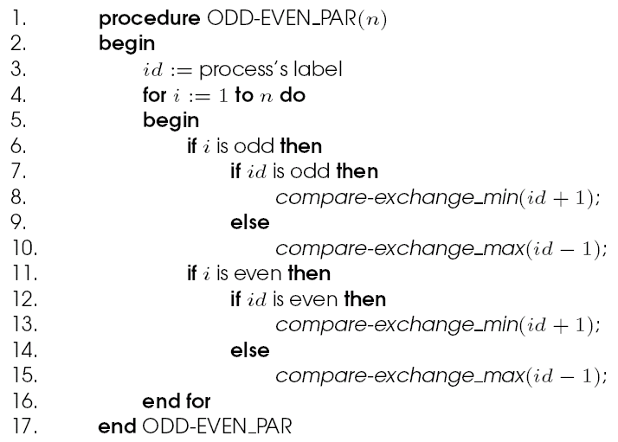
Parallel Odd-Even Transposition
Parallel formulation of odd-even transposition.

Slide 33
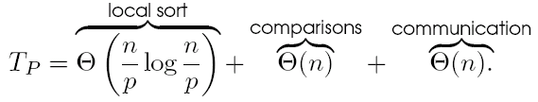
Parallel Odd-Even Transposition
Consider a block of n/p elements per processor.
The first step is a local sort.
In each subsequent step, the compare exchange operation is replaced by the compare split operation.
The parallel run time of the formulation is

Slide 34
Quicksort
Quicksort is one of the most common sorting algorithms for sequential computers because of its simplicity, low overhead, and optimal average complexity.
Quicksort selects one of the entries in the sequence to be the pivot and divides the sequence into two - one with all elements less than the pivot and other greater.
The process is recursively applied to each of the sublists.

Slide 35
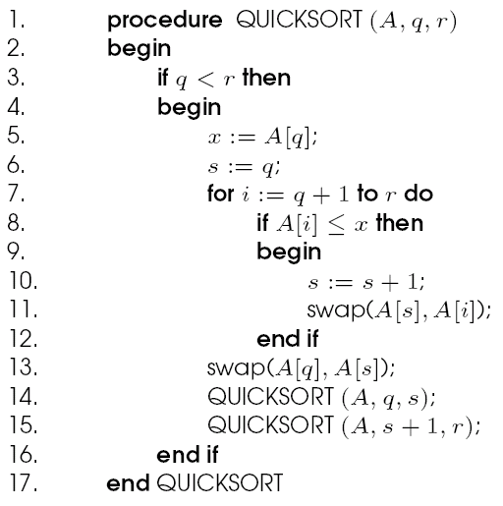
Quicksort
The sequential quicksort algorithm.

Slide 36
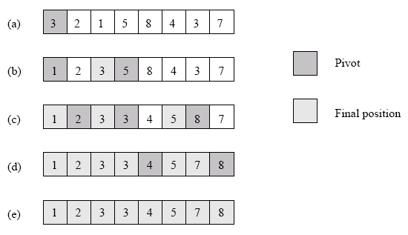
Quicksort
Example of the quicksort algorithm sorting a sequence of size n = 8.

Slide 37
Quicksort
The performance of quicksort depends critically on the quality of the pivot.
In the best case, the pivot divides the list in such a way that the larger of the two lists does not have more than αn elements (for some constant α).
In this case, the complexity of quicksort is O(nlog n).

Slide 38
Parallelizing Quicksort
Lets start with recursive decomposition - the list is partitioned serially and each of the subproblems is handled by a different processor.
The time for this algorithm is lower-bounded by Ω(n)!
Can we parallelize the partitioning step - in particular, if we can use n processors to partition a list of length n around a pivot in O(1) time, we have a winner.
This is difficult to do on real machines, though.

Slide 39
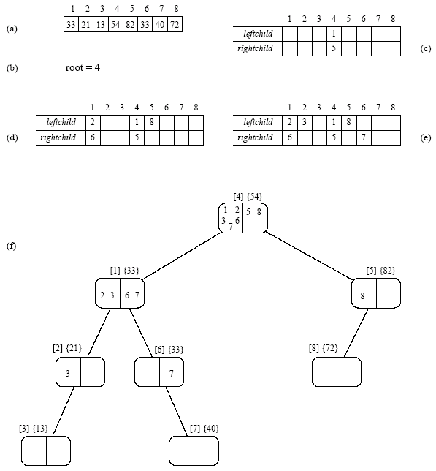
Parallelizing Quicksort: Parallel Random Access Machines (PRAM) Formulation
The execution of the PRAM algorithm on the array shown in (a).

Slide 40
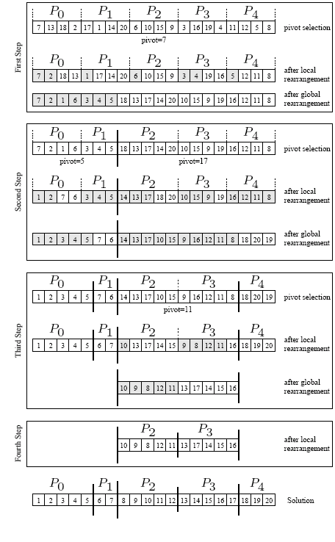
Shared Address Space Formulation

Slide 41
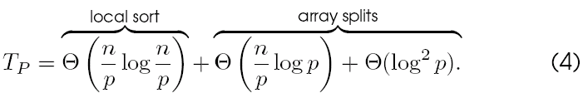
Parallelizing Quicksort: Shared Address Space Formulation
The process recurses until there are p lists, at which point, the lists are sorted locally.
Therefore, the total parallel time is:
The corresponding isoefficiency is Θ(plog²p) due to broadcast and scan operations.

Slide 42
Bucket and Sample Sort
In Bucket sort, the range [a,b] of input numbers is divided into m equal sized intervals, called buckets.
Each element is placed in its appropriate bucket.
If the numbers are uniformly divided in the range, the buckets can be expected to have roughly identical number of elements.
Elements in the buckets are locally sorted.
The run time of this algorithm is Θ(nlog(n/m)).

Slide 43
Parallel Bucket Sort
Parallelizing bucket sort is relatively simple. We can select m = p.
In this case, each processor has a range of values it is responsible for.
Each processor runs through its local list and assigns each of its elements to the appropriate processor.
The elements are sent to the destination processors using a single all-to-all personalized communication.
Each processor sorts all the elements it receives.

Slide 44
Parallel Bucket and Sample Sort
The critical aspect of the above algorithm is one of assigning ranges to processors. This is done by suitable splitter selection.
The splitter selection method divides the n elements into m blocks of size n/m each, and sorts each block by using quicksort.
From each sorted block it chooses m – 1 evenly spaced elements.
The m(m – 1) elements selected from all the blocks represent the sample used to determine the buckets.
This scheme guarantees that the number of elements ending up in each bucket is less than 2n/m.

Slide 45
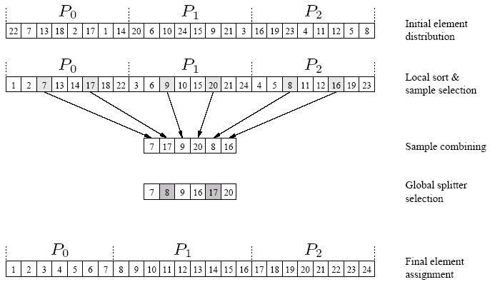
Parallel Bucket and Sample Sort
An example of the execution of sample sort on an array with 24 elements on three processes.

Slide 46
Parallel Bucket and Sample Sort
The splitter selection scheme can itself be parallelized.
Each processor generates the p – 1 local splitters in parallel.
All processors share their splitters using a single all-to-all broadcast operation.
Each processor sorts the p(p – 1) elements it receives and selects p – 1 uniformly spaces splitters from them.

Slide 47
Parallel Bucket and Sample Sort: Analysis
The internal sort of n/p elements requires time Θ((n/p)log(n/p)), and the selection of p – 1 sample elements requires time Θ(p).
The time for an all-to-all broadcast is Θ(p²), the time to internally sort the p(p – 1) sample elements is Θ(p²log p), and selecting p – 1 evenly spaced splitters takes time Θ(p).
Each process can insert these p – 1splitters in its local sorted block of size n/p by performing p – 1 binary searches in time Θ(plog(n/p)).
The time for reorganization of the elements is O(n/p).

Slide 48
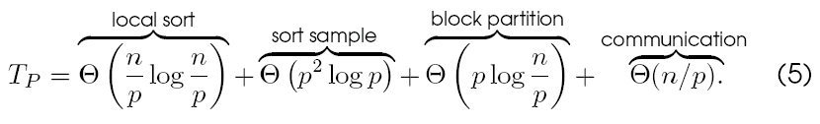
Parallel Bucket and Sample Sort: Analysis
The total time is given by:
The isoefficiency of the formulation is Θ(p³log p).

Slide 49
Non-numerical Algorithms
Sorting
Graph algorithms
Search algorithms for discrete optimization problems
Dynamic programming

Slide 50
Definitions and Representation
An undirected graph G is a pair (V,E), where V is a finite set of points called vertices and E is a finite set of edges.
An edge e ∈ E is an unordered pair (u,v), where u,v ∈ V.
In a directed graph, the edge e is an ordered pair (u,v). An edge (u,v) is incident from vertex u and is incident to vertex v.
A path from a vertex v to a vertex u is a sequence <v₀,v₁,v₂,…,v_{k}> of vertices where v₀ = v, v_{k} = u, and (v_{i}, v_{i+1}) ∈ E for I = 0, 1,…, k-1.
The length of a path is defined as the number of edges in the path.

Slide 51
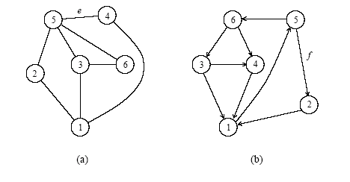
Definitions and Representation
a) An undirected graph and (b) a directed graph.

Slide 52
Definitions and Representation
An undirected graph is connected if every pair of vertices is connected by a path.
A forest is an acyclic graph, and a tree is a connected acyclic graph.
A graph that has weights associated with each edge is called a weighted graph.

Slide 53
Definitions and Representation
Graphs can be represented by their adjacency matrix or an edge (or vertex) list.
Adjacency matrices have a value a_{i,j} = 1 if nodes i and j share an edge; 0 otherwise. In case of a weighted graph, a_{i,j} = w_{i,j}, the weight of the edge.
The adjacency list representation of a graph G = (V,E) consists of an array Adj[1..|V|] of lists. Each list Adj[v] is a list of all vertices adjacent to v.
For a grapn with n nodes, adjacency matrices take Θ(n²) space and adjacency list takes Θ(|E|) space.

Slide 54
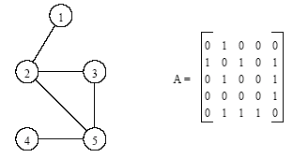
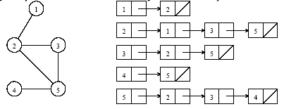
Definitions and Representation
An undirected graph and its adjacency matrix representation.
An undirected graph and its adjacency list representation.

Slide 55
Minimum Spanning Tree
A spanning tree of an undirected graph G is a subgraph of G that is a tree containing all the vertices of G.
In a weighted graph, the weight of a subgraph is the sum of the weights of the edges in the subgraph.
A minimum spanning tree (MST) for a weighted undirected graph is a spanning tree with minimum weight.

Slide 56
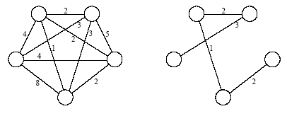
Minimum Spanning Tree
An undirected graph and its minimum spanning tree.

Slide 57
Minimum Spanning Tree: Prim's Algorithm
Prim's algorithm for finding an MST is a greedy algorithm.
Start by selecting an arbitrary vertex, include it into the current MST.
Grow the current MST by inserting into it the vertex closest to one of the vertices already in current MST.

Slide 58
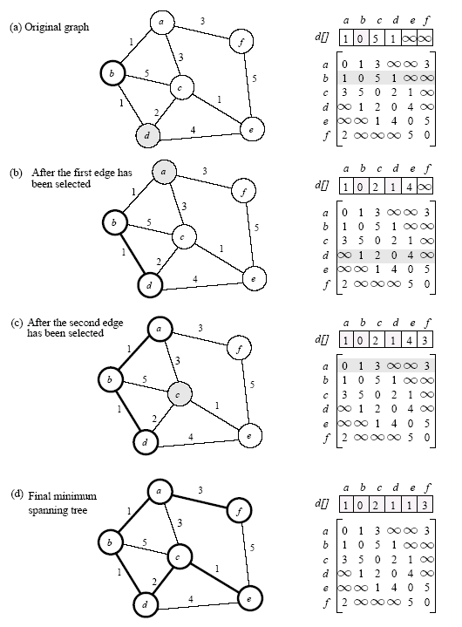
Minimum Spanning Tree: Prim's Algorithm
Prim's minimum spanning tree algorithm.

Slide 59
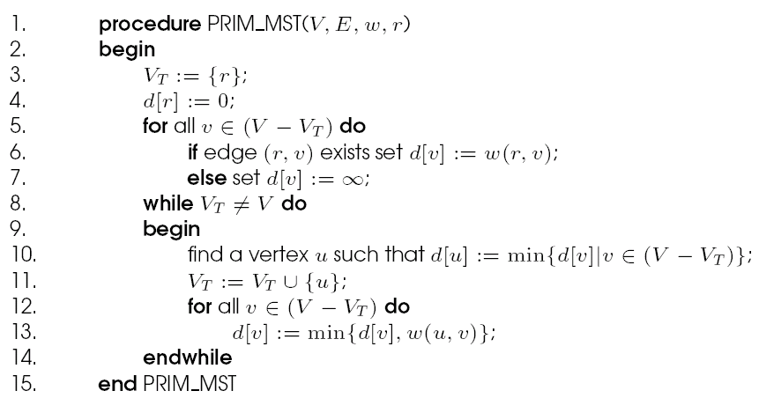
Minimum Spanning Tree: Prim's Algorithm
Prim's sequential minimum spanning tree algorithm.

Slide 60
Prim's Algorithm: Parallel Formulation
The algorithm works in n outer iterations - it is hard to execute these iterations concurrently.
The inner loop is relatively easy to parallelize. Let p be the number of processes, and let n be the number of vertices.
The adjacency matrix is partitioned in a 1-D block fashion, with distance vector d partitioned accordingly.
In each step, a processor selects the locally closest node, followed by a global reduction to select globally closest node.
This node is inserted into MST, and the choice broadcast to all processors.
Each processor updates its part of the d vector locally.

Slide 61
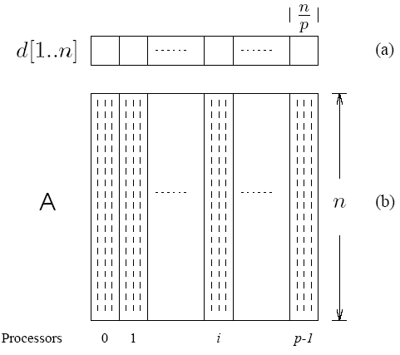
Prim's Algorithm: Parallel Formulation
The partitioning of the distance array d and the adjacency matrix A among p processes.

Slide 62
Prim's Algorithm: Parallel Formulation
The cost to select the minimum entry is O(n/p + log p).
The cost of a broadcast is O(log p).
The cost of local updation of the d vector is O(n/p).
The parallel time per iteration is O(n/p + log p).
The total parallel time is given by O(n²/p + n log p).
The corresponding isoefficiency is O(p²log²p).

Slide 63
Single-Source Shortest Paths
For a weighted graph G = (V,E,w), the single-source shortest paths problem is to find the shortest paths from a vertex v ∈ V to all other vertices in V.
Dijkstra's algorithm is similar to Prim's algorithm. It maintains a set of nodes for which the shortest paths are known.
It grows this set based on the node closest to source using one of the nodes in the current shortest path set.

Slide 64
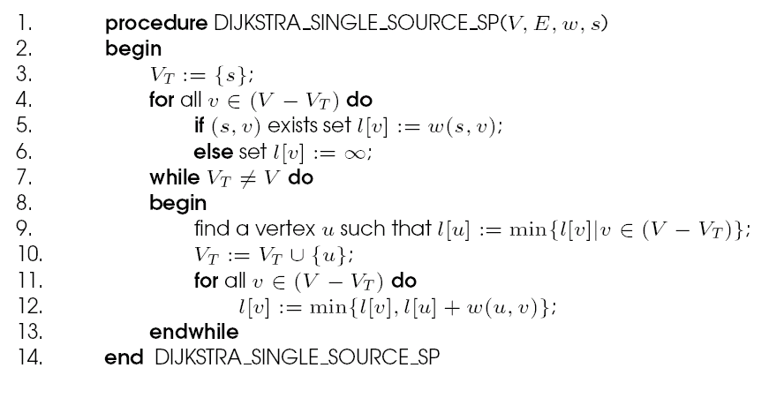
Single-Source Shortest Paths: Dijkstra's Algorithm
Dijkstra's sequential single-source shortest paths algorithm.

Slide 65
Dijkstra's Algorithm: Parallel Formulation
Very similar to the parallel formulation of Prim's algorithm for minimum spanning trees.
The weighted adjacency matrix is partitioned using the 1-D block mapping.
Each process selects, locally, the node closest to the source, followed by a global reduction to select next node.
The node is broadcast to all processors and the l-vector updated.
The parallel performance of Dijkstra's algorithm is identical to that of Prim's algorithm.

Slide 66
All-Pairs Shortest Paths
Given a weighted graph G(V,E,w), the all-pairs shortest paths problem is to find the shortest paths between all pairs of vertices v_{i}, v_{j} ∈ V.
A number of algorithms are known for solving this problem.

Slide 67
All-Pairs Shortest Paths: Matrix-Multiplication Based Algorithm
Consider the multiplication of the weighted adjacency matrix with itself - except, in this case, we replace the multiplication operation in matrix multiplication by addition, and the addition operation by minimization.
Notice that the product of weighted adjacency matrix with itself returns a matrix that contains shortest paths of length 2 between any pair of nodes.
It follows from this argument that A^{n} contains all shortest paths.

Slide 68
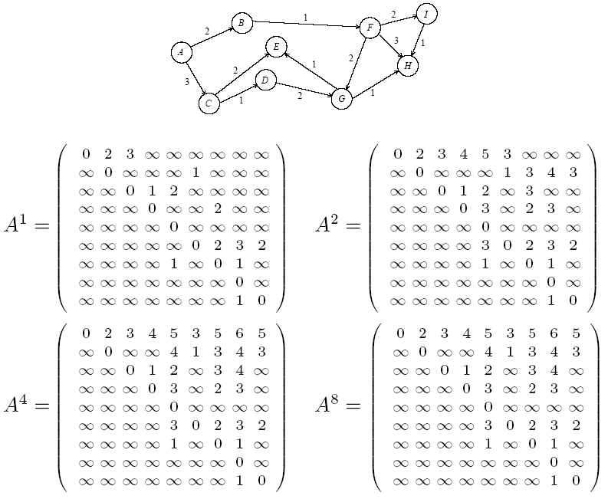
Matrix-Multiplication Based Algorithm

Slide 69
Matrix-Multiplication Based Algorithm
A^{n} is computed by doubling powers - i.e., as A, A², A⁴, A⁸, and so on.
We need log n matrix multiplications, each taking time O(n³).
The serial complexity of this procedure is O(n³log n).
This algorithm is not optimal, since the best known algorithms have complexity O(n³).

Slide 70
Matrix-Multiplication Based Algorithm: Parallel Formulation
Each of the log n matrix multiplications can be performed in parallel.
We can use n³/log n processors to compute each matrix-matrix product in time log n.
The entire process takes O(log²n) time.

Slide 71
Transitive Closure
If G = (V,E) is a graph, then the transitive closure of G is defined as the graph G* = (V,E*), where E* = {(v_{i},v_{j}) | there is a path from v_{i} to v_{j} in G}
The connectivity matrix of G is a matrix A* = (a_{i}*_{,j}) such that a_{i}*_{,j} = 1 if there is a path from v_{i} to v_{j} or i = j, and a_{i}*_{,j} = ∞ otherwise.
To compute A* we assign a weight of 1 to each edge of E and use any of the all-pairs shortest paths algorithms on this weighted graph.

Slide 72
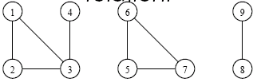
Connected Components
The connected components of an undirected graph are the equivalence classes of vertices under the ``is reachable from'' relation.
A graph with three connected components: {1,2,3,4}, {5,6,7}, and {8,9}.

Slide 73
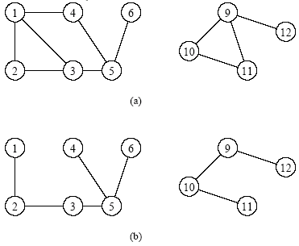
Connected Components: Depth-First Search Based Algorithm
Perform DFS on the graph to get a forest - eac tree in the forest corresponds to a separate connected component.
Part (b) is a depth-first forest obtained from depth-first traversal of the graph in part (a). Each of these trees is a connected component of the graph in part (a).

Slide 74
Connected Components: Parallel Formulation
Partition the graph across processors and run independent connected component algorithms on each processor. At this point, we have p spanning forests.
In the second step, spanning forests are merged pairwise until only one spanning forest remains.

Slide 75
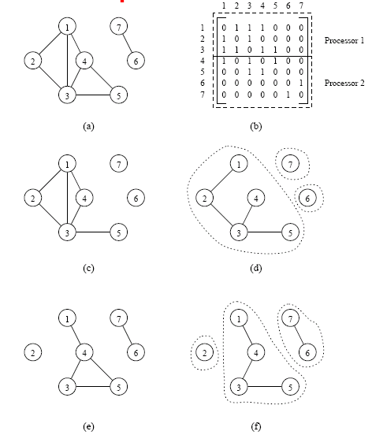
Connected Components: Parallel Formulation
Computing connected components in parallel. The adjacency matrix of the graph G in (a) is partitioned into two parts (b). Each process gets a subgraph of G ((c) and (e)). Each process then computes the spanning forest of the subgraph ((d) and (f)). Finally, the two spanning trees are merged to form the solution.

Slide 76
Connected Components: Parallel Formulation
To merge pairs of spanning forests efficiently, the algorithm uses disjoint sets of edges.
We define the following operations on the disjoint sets:
find(x)
  returns a pointer to the representative element of the set containing x . Each set has its own unique representative.
union(x, y)
  unites the sets containing the elements x and y. The two sets are assumed to be disjoint prior to the operation.

Slide 77
Connected Components: Parallel Formulation
For merging forest A into forest B, for each edge (u,v) of A, a find operation is performed to determine if the vertices are in the same tree of B.
If not, then the two trees (sets) of B containing u and v are united by a union operation.
Otherwise, no union operation is necessary.
Hence, merging A and B requires at most 2(n-1) find operations and (n-1) union operations.

Slide 78
Non-numerical Algorithms
Sorting
Graph algorithms
Search algorithms for discrete optimization problems
Dynamic programming

Slide 79
Discrete Optimization - Basics
Discrete optimization forms a class of computationally expensive problems of significant theoretical and practical interest.
Search algorithms systematically search the space of possible solutions subject to constraints.

Slide 80
Discrete Optimization: Example
The 8-puzzle problem consists of a 3×3 grid containing eight tiles, numbered one through eight.
One of the grid segments (called the “blank’”) is empty. A tile can be moved into the blank position from a position adjacent to it, thus creating a blank in the tile's original position.
The goal is to move from a given initial position to the final position in a minimum number of moves.

Slide 81
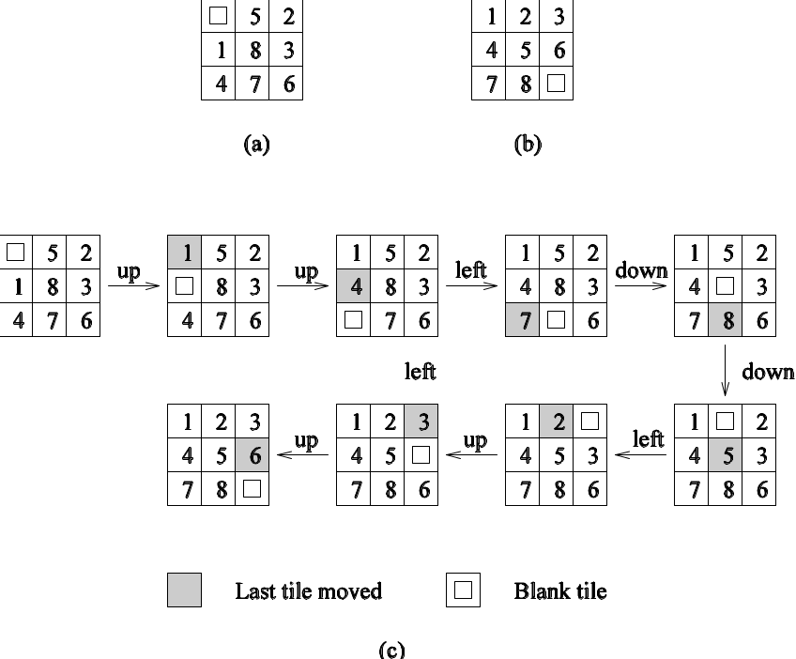
Discrete Optimization: Example
An 8-puzzle problem instance: (a) initial configuration; (b) final configuration; and (c) a sequence of moves leading from the initial to the final configuration.

Slide 82
Discrete Optimization: Example
An admissible heuristic for 8-puzzle is as follows:
Assume that each position in the 8-puzzle grid is represented as a pair.
The distance between positions (i,j) and (k,l) is defined as |i - k| + |j - l|. This distance is called the Manhattan distance.
The sum of the Manhattan distances between the initial and final positions of all tiles is an admissible heuristic.

Slide 83
Depth-First Search Algorithms
Applies to search spaces that are trees.
DFS begins by expanding the initial node and generating its successors. In each subsequent step, DFS expands one of the most recently generated nodes.
If there exists no success, DFS backtracks to the parent and explores an alternate child.
Often, successors of a node are ordered based on their likelihood of reaching a solution. This is called directed DFS.
The main advantage of DFS is that its storage requirement is linear in the depth of the state space being searched.

Slide 84
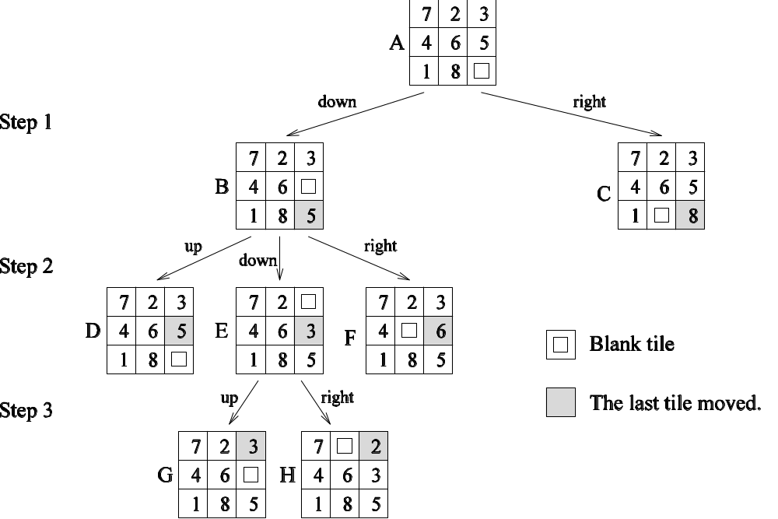
Depth-First Search Algorithms
States resulting from the first three steps of depth-first search applied to an instance of the 8-puzzle.

Slide 85
DFS Algorithms: Simple Backtracking
Simple backtracking performs DFS until it finds the first feasible solution and terminates.
Not guaranteed to find a minimum-cost solution.
Uses no heuristic information to order the successors of an expanded node.
Ordered backtracking uses heuristics to order the successors of an expanded node.

Slide 86
Depth-First Branch-and-Bound (DFBB)
DFS technique in which upon finding a solution, the algorithm updates current best solution.
DFBB does not explore paths that are guaranteed to lead to solutions worse than current best solution.
On termination, the current best solution is a globally optimal solution.

Slide 87
Iterative Deepening Search
Often, the solution may exist close to the root, but on an alternate branch.
Simple backtracking might explore a large space before finding this.
Iterative deepening sets a depth bound on the space it searches (using DFS).
If no solution is found, the bound is increased and the process repeated.

Slide 88
Iterative Deepening A* (IDA*)
Uses a bound on the cost of the path as opposed to the depth.
IDA* defines a function for node x in the search space as l(x) = g(x) + h(x). Here, g(x) is the cost of getting to the node and h(x) is a heuristic estimate of the cost of getting from the node to the solution.
At each failed step, the cost bound is incremented to that of the node that exceeded the prior cost bound by the least amount.
If the heuristic h is admissible, the solution found by IDA* is optimal.

Slide 89
DFS Storage Requirements and Data Structures
At each step of DFS, untried alternatives must be stored for backtracking.
If m is the amount of storage required to store a state, and d is the maximum depth, then the total space requirement of the DFS algorithm is O(md).
The state-space tree searched by parallel DFS can be efficiently represented as a stack.
Memory requirement of the stack is linear in depth of tree.

Slide 90
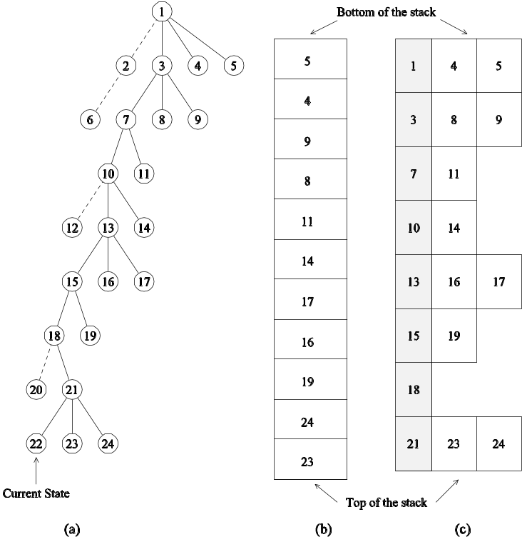
DFS Storage Requirements and Data Structures
Representing a DFS tree: (a) the DFS tree; Successor nodes shown with dashed lines have already been explored; (b) the stack storing untried alternatives only; and (c) the stack storing untried alternatives along with their parent. The shaded blocks represent the parent state and the block to the right represents successor states that have not been explored.

Slide 91
Best-First Search (BFS) Algorithms
BFS algorithms use a heuristic to guide search.
The core data structure is a list, called Open list, that stores unexplored nodes sorted on their heuristic estimates.
The best node is selected from the list, expanded, and its off-spring are inserted at the right position.
If the heuristic is admissible, the BFS finds the optimal solution.

Slide 92
Best-First Search (BFS) Algorithms
BFS of graphs must be slightly modified to account for multiple paths to the same node.
A closed list stores all the nodes that have been previously seen.
If a newly expanded node exists in the open or closed lists with better heuristic value, the node is not inserted into the open list.

Slide 93
The A* Algorithm
A BFS technique that uses admissible heuristics.
Defines function l(x) for each node x as g(x) + h(x).
Here, g(x) is the cost of getting to node x and h(x) is an admissible heuristic estimate of getting from node x to the solution.
The open list is sorted on l(x).
The space requirement of BFS is exponential in depth!

Slide 94
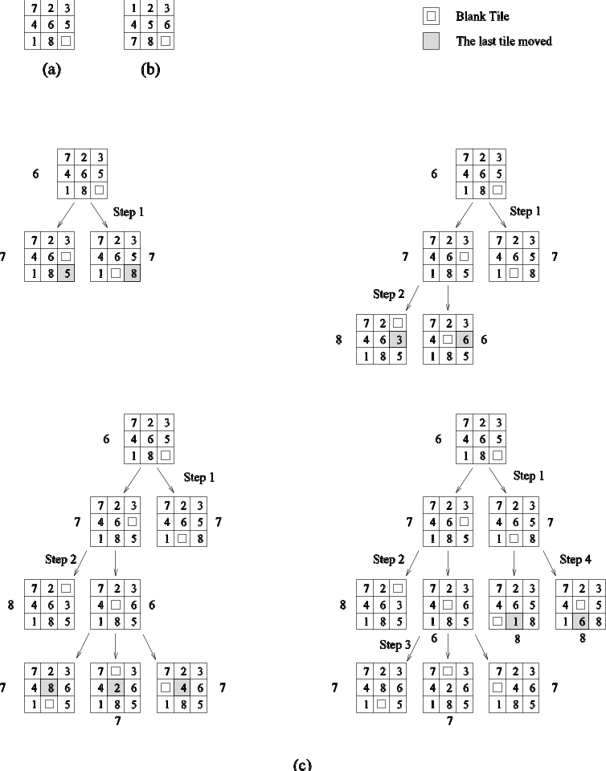
Best-First Search: Example
Applying best-first search to the 8-puzzle: (a) initial configuration; (b) final configuration; and (c) states resulting from the first four steps of best-first search. Each state is labeled with its -value (that is, the Manhattan distance from the state to the final state).

Slide 95
Parallel Depth-First Search
How is the search space partitioned across processors?
Different subtrees can be searched concurrently.
However, subtrees can be very different in size.
It is difficult to estimate the size of a subtree rooted at a node.
Dynamic load balancing is required.

Slide 96
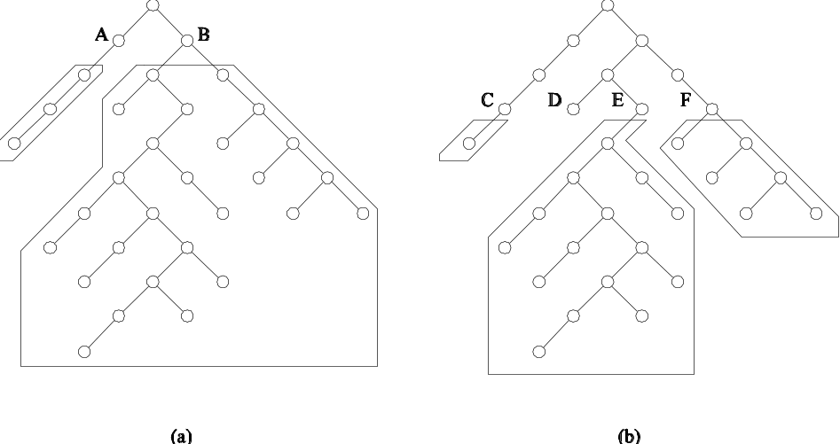
Parallel Depth-First Search
The unstructured nature of tree search and the imbalance resulting from static partitioning.

Slide 97
Parameters in Parallel DFS: Work Splitting
Work is split by splitting the stack into two.
Ideally, we do not want either of the split pieces to be small.
Select nodes near the bottom of the stack (node splitting), or
Select some nodes from each level (stack splitting).
The second strategy generally yields a more even split of the space.

Slide 98
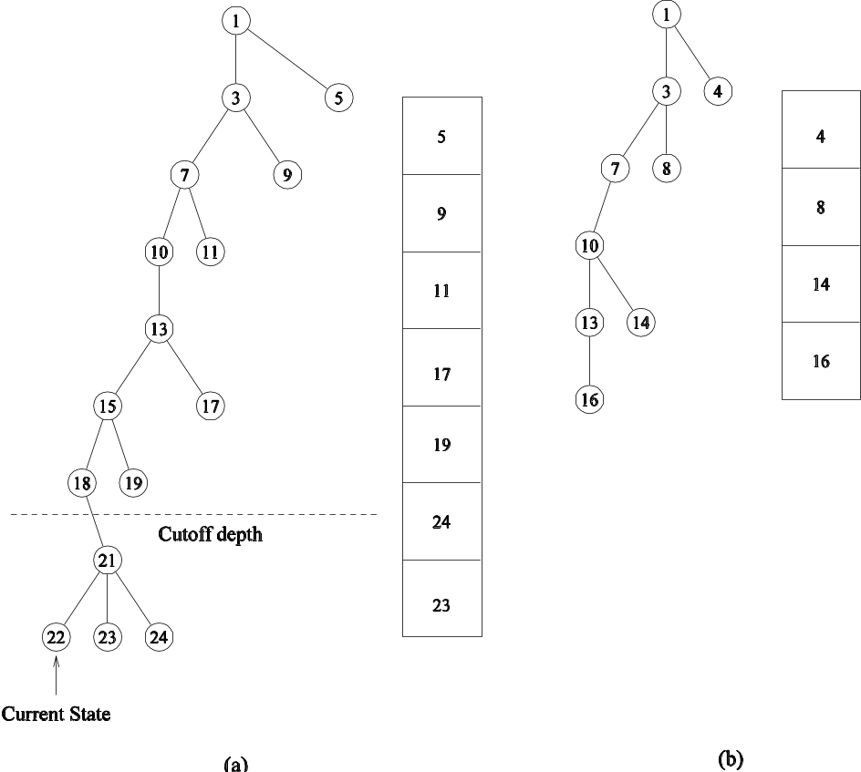
Parameters in Parallel DFS: Work Splitting
Splitting the DFS tree: the two subtrees along with their stack representations are shown in (a) and (b).

Slide 99
Parallel Formulations of Depth-First Branch-and-Bound
Parallel formulations of depth-first branch-and-bound search (DFBB) are similar to those of DFS.
Each processor has a copy of the current best solution. This is used as a local bound.
If a processor detects another solution, it compares the cost with current best solution. If the cost is better, it broadcasts this cost to all processors.
If a processor's current best solution path is worse than the globally best solution path, only the efficiency of the search is affected, not its correctness.

Slide 100
Parallel Formulations of IDA*
Two formulations are intuitive.
Common Cost Bound: Each processor is given the same cost bound. Processors use parallel DFS on the tree within the cost bound. The drawback of this scheme is that there might not be enough concurrency.
Variable Cost Bound: Each processor works on a different cost bound. The major drawback here is that a solution is not guaranteed to be optimal until all lower cost bounds have been exhausted.
In each case, parallel DFS is the search kernel.

Slide 101
Parallel Best-First Search
The core data structure is the Open list (typically implemented as a priority queue).
Each processor locks this queue, extracts the best node, unlocks it.
Successors of the node are generated, their heuristic functions estimated, and the nodes inserted into the open list as necessary after appropriate locking.
Termination signaled when we find a solution whose cost is better than the best heuristic value in the open list.
Since we expand more than one node at a time, we may expand nodes that would not be expanded by a sequential algorithm.

Slide 102
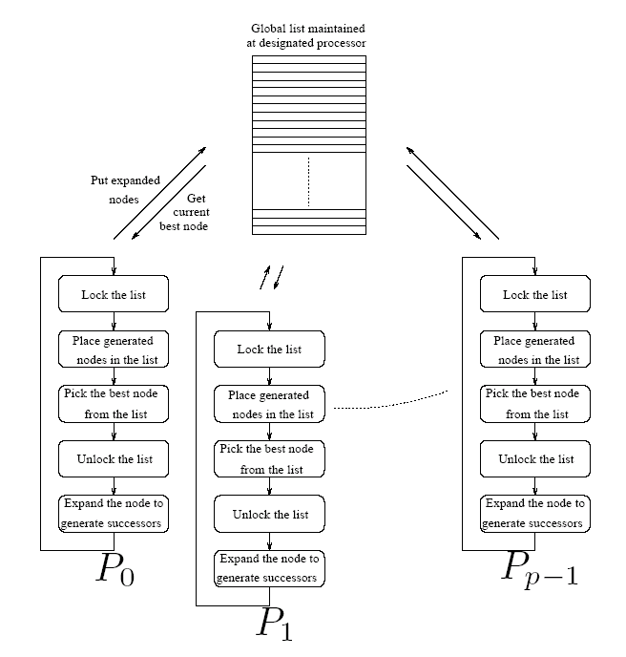
Parallel Best-First Search
A general schematic for parallel best-first search using a centralized strategy. The locking operation is used here to serialize queue access by various processors.

Slide 103
Parallel Best-First Search
The open list is a point of contention.
Let t_{exp} be the average time to expand a single node, and t_{access} be the average time to access the open list for a single-node expansion.
If there are n nodes to be expanded by both the sequential and parallel formulations (assuming that they do an equal amount of work), then the sequential run time is given by n(t_{access}+ t_{exp}).
The parallel run time will be at least nt_{access}.
Upper bound on the speedup is (t_{access}+ t_{exp})/t_{access}

Slide 104
Parallel Best-First Search
Avoid contention by having multiple open lists.
Initially, the search space is statically divided across these open lists.
Processors concurrently operate on these open lists.
Since the heuristic values of nodes in these lists may diverge significantly, we must periodically balance the quality of nodes in each list.
A number of balancing strategies based on ring, blackboard, or random communications are possible.

Slide 105
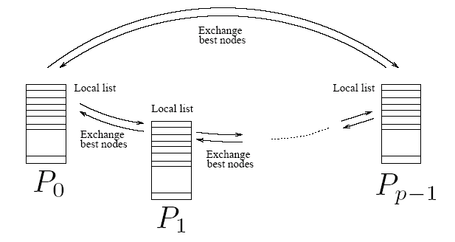
Parallel Best-First Search
A message-passing implementation of parallel best-first search using the ring communication strategy.

Slide 106
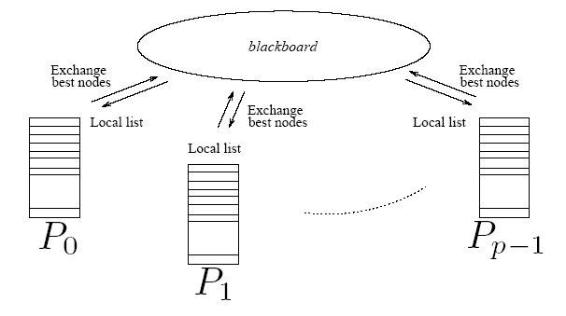
Parallel Best-First Search
An implementation of parallel best-first search using the blackboard communication strategy.

Slide 107
Parallel Best-First Graph Search
Graph search involves a closed list, where the major operation is a lookup (on a key corresponding to the state).
The classic data structure is a hash.
Hashing can be parallelized by using two functions - the first one hashes each node to a processor, and the second one hashes within the processor.
This strategy can be combined with the idea of multiple open lists.
If a node does not exist in a closed list, it is inserted into the open list at the target of the first hash function.
In addition to facilitating lookup, randomization also equalizes quality of nodes in various open lists.

Slide 108
Non-numerical Algorithms
Sorting
Graph algorithms
Search algorithms for discrete optimization problems
Dynamic programming

Slide 109
Overview of Serial Dynamic Programming
Dynamic programming (DP) is used to solve a wide variety of discrete optimization problems such as scheduling, string-editing, packaging, and inventory management.
Break problems into subproblems and combine their solutions into solutions to larger problems.
In contrast to divide-and-conquer, there may be relationships across subproblems.

Slide 110
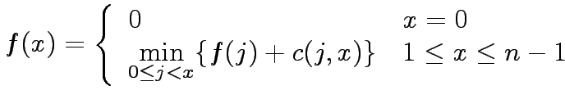
Dynamic Programming: Example
Consider the problem of finding a shortest path between a pair of vertices in an acyclic graph.
An edge connecting node i to node j has cost c(i,j).
The graph contains n nodes numbered 0,1,…, n-1, and has an edge from node i to node j only if i < j. Node 0 is source and node n-1 is the destination.
Let f(x) be the cost of the shortest path from node 0 to node x.

Slide 111
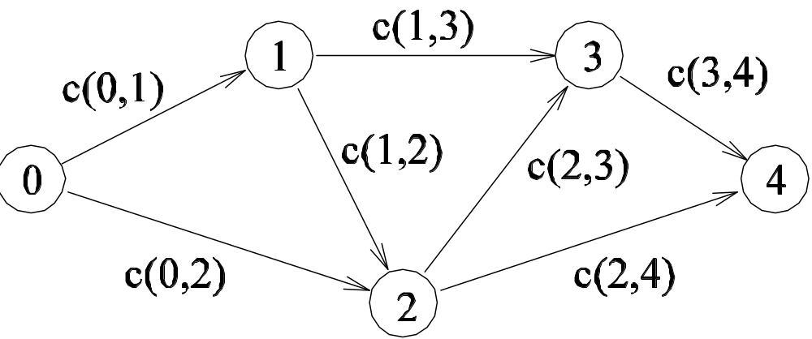

Dynamic Programming: Example
A graph for which the shortest path between nodes 0 and 4 is to be computed.

Slide 112

Dynamic Programming
The solution to a DP problem is typically expressed as a minimum (or maximum) of possible alternate solutions.
If r represents the cost of a solution composed of subproblems x₁, x₂,…, x_{l}, then r can be written as
Here, g is the composition function.
If the optimal solution to each problem is determined by composing optimal solutions to the subproblems and selecting the minimum (or maximum), the formulation is said to be a DP formulation.

Slide 113
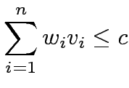

0/1 Knapsack Problem
We are given a knapsack of capacity c and a set of n objects numbered 1,2,…,n. Each object i has weight w_{i} and profit p_{i}.
Let v = [v₁, v₂,…, v_{n}] be a solution vector in which v_{i} = 0 if object i is not in the knapsack, and v_{i} = 1 if it is in the knapsack.
The goal is to find a subset of objects to put into the knapsack so that
(that is, the objects fit into the knapsack) and
is maximized (that is, the profit is maximized).

Slide 114

0/1 Knapsack Problem
The naive method is to consider all 2^{n} possible subsets of the n objects and choose the one that fits into the knapsack and maximizes the profit.
Let F[i,x] be the maximum profit for a knapsack of capacity x using only objects {1,2,…,i}. The DP formulation is:

Slide 115
0/1 Knapsack Problem
Construct a table F of size n x c in row-major order.
Filling an entry in a row requires two entries from the previous row: one from the same column and one from the column offset by the weight of the object corresponding to the row.
Computing each entry takes constant time; the sequential run time of this algorithm is Θ(nc).
The formulation is serial-monadic.

Slide 116

0/1 Knapsack Problem
Computing entries of table F for the 0/1 knapsack problem. The computation of entry F[i,j] requires communication with processing elements containing entries F[i-1,j] and F[i-1,j-w_{i}].

Slide 117
0/1 Knapsack Problem
Using c processors in a PRAM, we can derive a simple parallel algorithm that runs in O(n) time by partitioning the columns across processors.
In a distributed memory machine, in the j^{th} iteration, for computing F[j,r] at processing element P_{r-1}, F[j-1,r] is available locally but F[j-1,r-w_{j}] must be fetched.
The communication operation is a circular shift and the time is given by (t_{s} + t_{w}) log c. The total time is therefore t_{c} + (t_{s} + t_{w}) log c.
Across all n iterations (rows), the parallel time is O(n log c). Note that this is not cost optimal.

Slide 118
0/1 Knapsack Problem
Using p-processing elements, each processing element computes c/p elements of the table in each iteration.
The corresponding shift operation takes time (2t_{s} + t_{w}c/p), since the data block may be partitioned across two processors, but the total volume of data is c/p.
The corresponding parallel time is n(t_{c}c/p + 2t_{s} + t_{w}c/p), or O(nc/p) (which is cost-optimal).
Note that there is an upper bound on the efficiency of this formulation.

Slide 119
Nonserial Monadic DP Formulations: Longest-Common-Subsequence
Given a sequence A = <a₁, a₂,…, a_{n}>, a subsequence of A can be formed by deleting some entries from A.
Given two sequences A = <a₁, a₂,…, a_{n}> and B = <b₁, b₂,…, b_{m}>, find the longest sequence that is a subsequence of both A and B.
If A = <c,a,d,b,r,z> and B = <a,s,b,z>, the longest common subsequence of A and B is <a,b,z>.

Slide 120

Longest-Common-Subsequence Problem
Let F[i,j] denote the length of the longest common subsequence of the first i elements of A and the first j elements of B. The objective of the LCS problem is to find F[n,m].
We can write:

Slide 121
Longest-Common-Subsequence Problem
The algorithm computes the two-dimensional F table in a row- or column-major fashion. The complexity is Θ(nm).
Treating nodes along a diagonal as belonging to one level, each node depends on two subproblems at the preceding level and one subproblem two levels prior.
This DP formulation is nonserial monadic.

Slide 122

Longest-Common-Subsequence Problem
(a) Computing entries of table for the longest-common-subsequence problem. Computation proceeds along the dotted diagonal lines. (b) Mapping elements of the table to processing elements.

Slide 123

Longest-Common-Subsequence: Example
Consider the LCS of two amino-acid sequences H E A G A W G H E E and P A W H E A E. For the interested reader, the names of the corresponding amino-acids are A: Alanine, E: Glutamic acid, G: Glycine, H: Histidine, P: Proline, and W: Tryptophan.
The F table for computing the LCS of the sequences. The LCS is A W H E E.

Slide 124
Parallel Longest-Common-Subsequence
Table entries are computed in a diagonal sweep from the top-left to the bottom-right corner.
Using n processors in a PRAM, each entry in a diagonal can be computed in constant time.
For two sequences of length n, there are 2n-1 diagonals.
The parallel run time is Θ(n) and the algorithm is cost-optimal.

Slide 125

Parallel Longest-Common-Subsequence
Consider a (logical) linear array of processors. Processing element P_{i} is responsible for the (i+1)^{th} column of the table.
To compute F[i,j], processing element P_{j-1} may need either F[i-1,j-1] or F[i,j-1] from the processing element to its left. This communication takes time t_{s} + t_{w}.
The computation takes constant time (t_{c}).
We have:
Note that this formulation is cost-optimal, however, its efficiency is upper-bounded by 0.5!
Can you think of how to fix this?

Slide 126
Discussion of Parallel Dynamic Programming Algorithms
By representing computation as a graph, we identify three sources of parallelism: parallelism within nodes, parallelism across nodes at a level, and pipelining nodes across multiple levels. The first two are available in serial formulations and the third one in non-serial formulations.
Data locality is critical for performance. Different DP formulations, by the very nature of the problem instance, have different degrees of locality.

Slide 127
Numerical algorithms
Dense matrix algorithms
Fast Fourier transforms

Slide 128
Topic Overview
Matrix-Vector Multiplication
Matrix-Matrix Multiplication
Solving a System of Linear Equations

Slide 129
Matix Algorithms: Introduction
Due to their regular structure, parallel computations involving matrices and vectors readily lend themselves to data-decomposition.
Typical algorithms rely on input, output, or intermediate data decomposition.
Most algorithms use one- and two-dimensional block, cyclic, and block-cyclic partitionings.

Slide 130

Matrix-Vector Multiplication
We aim to multiply a dense n x n matrix A with an n x 1 vector x to yield the n x 1 result vector y.
The serial algorithm requires n² multiplications and additions.

Slide 131
Matrix-Vector Multiplication:
Rowwise 1-D Partitioning
The n x n matrix is partitioned among n processors, with each processor storing complete row of the matrix.
The n x 1 vector x is distributed such that each process owns one of its elements.

Slide 132

Matrix-Vector Multiplication:
Rowwise 1-D Partitioning
Multiplication of an n x n matrix with an n x 1 vector using
rowwise block 1-D partitioning. For the one-row-per-process
case, p = n.

Slide 133

Matrix-Vector Multiplication:
Rowwise 1-D Partitioning
Since each process starts with only one element of x , an all-to-all broadcast is required to distribute all the elements to all the processes.
Process P_{i} now computes .
The all-to-all broadcast and the computation of y[i] both take time Θ(n) . Therefore, the parallel time is Θ(n) .

Slide 134
Matrix-Vector Multiplication:
2-D Partitioning
The n x n matrix is partitioned among n² processors such that each processor owns a single element.
The n x 1 vector x is distributed only in the last column of n processors.

Slide 135

Matrix-Vector Multiplication: 2-D Partitioning
Matrix-vector multiplication with block 2-D partitioning. For the
one-element-per-process case, p = n² if the matrix size is n x n .

Slide 136
Matrix-Vector Multiplication:
2-D Partitioning
We must first align the vector with the matrix appropriately.
The first communication step for the 2-D partitioning aligns the vector x along the principal diagonal of the matrix.
The second step copies the vector elements from each diagonal process to all the processes in the corresponding column using n simultaneous broadcasts among all processors in the column.
Finally, the result vector is computed by performing an all-to-one reduction along the columns.

Slide 137
Matrix-Vector Multiplication:
2-D Partitioning
Three basic communication operations are used in this algorithm: one-to-one communication to align the vector along the main diagonal, one-to-all broadcast of each vector element among the n processes of each column, and all-to-one reduction in each row.
Each of these operations takes Θ(log n) time and the parallel time is Θ(log n) .
The cost (process-time product) is Θ(n² log n) ; hence, the algorithm is not cost-optimal.

Slide 138
Matrix-Matrix Multiplication
Consider the problem of multiplying two n x n dense, square matrices A and B to yield the product matrix C =A x B.
The serial complexity is O(n³).
We do not consider better serial algorithms (Strassen's method), although, these can be used as serial kernels in the parallel algorithms.
A useful concept in this case is called block operations. In this view, an n x n matrix A can be regarded as a q x q array of blocks A_{i,j} (0 ≤ i, j < q) such that each block is an (n/q) x (n/q) submatrix.
In this view, we perform q³ matrix multiplications, each involving (n/q) x (n/q) matrices.

Slide 139

Solving a System of Linear Equations
Consider the problem of solving linear equations of the kind:
This is written as Ax = b, where A is an n x n matrix with A[i, j] = a_{i,j}, b is an n x 1 vector [ b₀, b₁, … , b_{n} ]^{T}, and x is the solution.

Slide 140

Solving a System of Linear Equations
Two steps in solution are: reduction to triangular form, and back-substitution. The triangular form is as:
We write this as: Ux = y .
A commonly used method for transforming a given matrix into an upper-triangular matrix is Gaussian Elimination.

Slide 141

Gaussian Elimination
Serial Gaussian Elimination

Slide 142

Gaussian Elimination
The computation has three nested loops - in the kth iteration of the outer loop, the algorithm performs (n-k)² computations. Summing from k = 1..n, we have roughly (n³/3) multiplications-subtractions.
A typical computation in Gaussian elimination.

Slide 143


Parallel Gaussian Elimination
Assume p = n with each row assigned to a processor.
The first step of the algorithm normalizes the row. This is a serial operation and takes time (n-k) in the kth iteration.
In the second step, the normalized row is broadcast to all the processors. This takes time .
Each processor can independently eliminate this row from its own. This requires (n-k-1) multiplications and subtractions.
The total parallel time can be computed by summing from k = 1 … n-1 as
The formulation is not cost optimal because of the t_{w} term.

Slide 144

Parallel Gaussian Elimination
Gaussian elimination steps during the iteration corresponding k = 3 for an 8 x 8 matrix partitioned rowwise among eight processes.

Slide 145
Numerical algorithms
Dense matrix algorithms
Fast Fourier transforms

Slide 146

Fast Fourier Transforms
FFT efficiently computes the Discrete Fourier Transform (DFT).
Parallel Implementation
  The FFT algorithm uses butterfly computations.
  Independent butterfly operations can run simultaneously on different processors.
Applications
  Signal processing
  Image compression
  Wireless communication
  Audio analysis

Slide 147
UNIT 3 ENDS!!!

